Slide 1



Amazon Sales analysis
View in Power BI
Last data refresh:
4/15/2024 2:29:13 AM UTC
Downloaded at:
4/15/2024 2:30:06 AM UTC

Slide 2
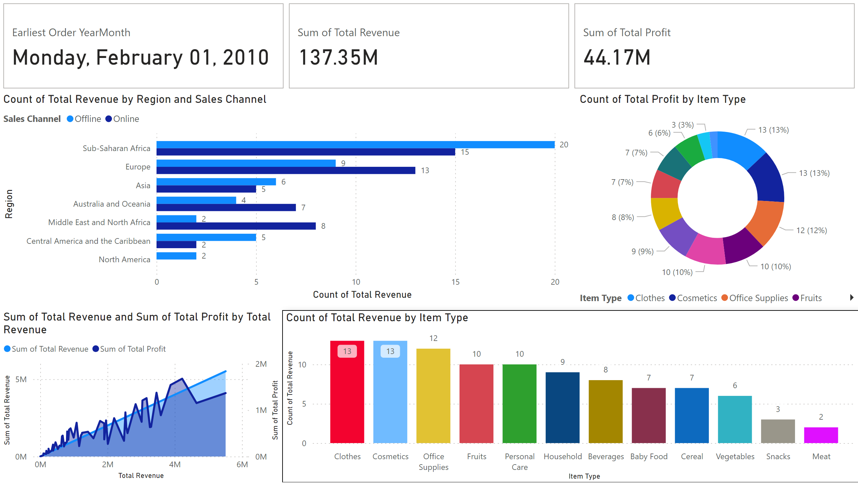
Page 1
Notes:
donutChart
No alt text provided
cardVisual
No alt text provided
clusteredBarChart
No alt text provided
lineStackedColumnComboChart
No alt text provided
areaChart
No alt text provided

Slide 3
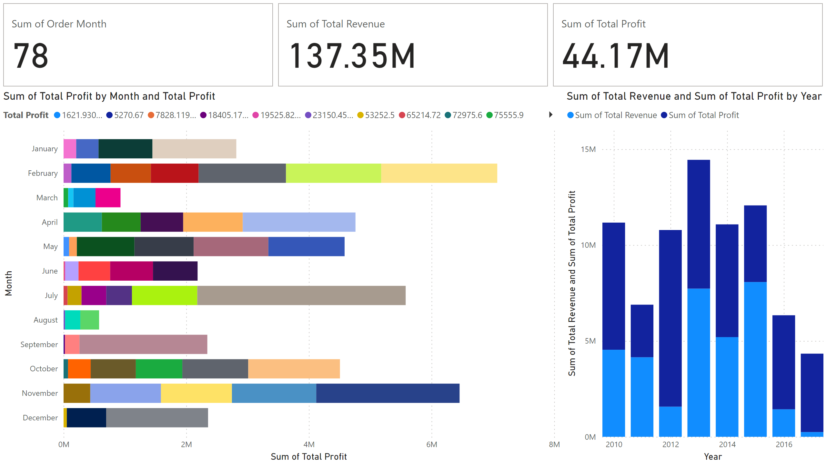
Page 2
Notes:
barChart
No alt text provided
cardVisual
No alt text provided
columnChart
No alt text provided

